Slide 1
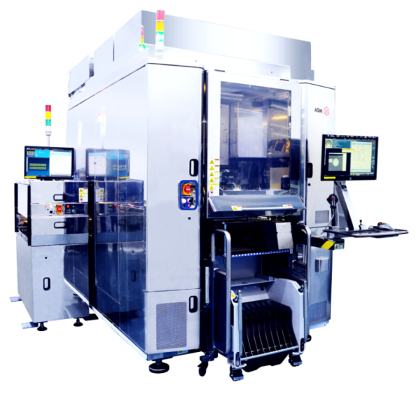
Firebird W
Rev.07.9

Slide 2
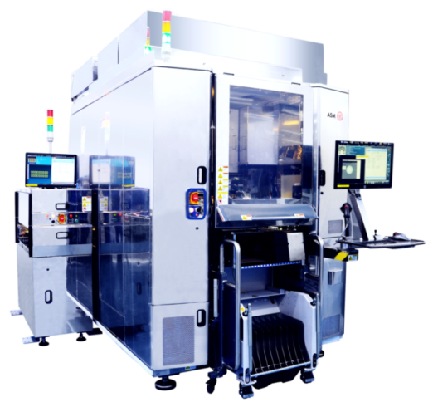
Firebird - Specifications
Basic performance
XY accuracy:
± 2.0μm @ 3σ
Angular accuracy:
± 0.01° @ Cpk 1.33
Z accuracy:
± 1μm @ Cpk 1.33
Co-planarity: 3μm over 33mm
Cycle Time < 2.0 sec
Process capabilities
Bond pedestal temperature:
Max 200°C ± 5°C
BH nozzle temperature:
Max 400°C ± 2°C
Ramp up rate > 450°C/sec (Die size<14x13mm)
> 125°C/sec (Die size > 14x13mm)
Cooling rate < -80°C/sec (Die size<14x13mm)
< -57°C/sec (Die size > 14x13mm)
Bond force: 0.1N ~ 10N ~ 300N
Accuracy: ± 5% @ Cpk 1.33
Inert environment:
O₂ level < 100ppm
Integrated jet dispenser (option)
Flux Dipping (option)
Multi-Chip
2016-09-07
Page 2

Slide 3
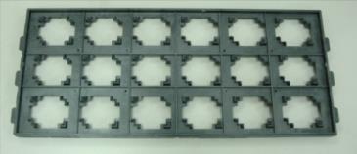
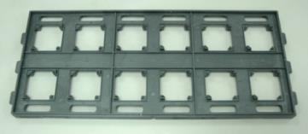
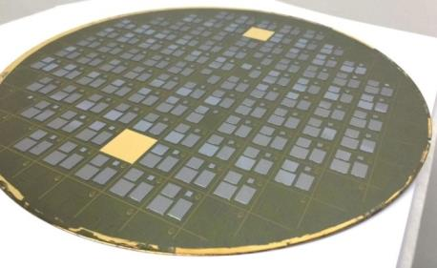
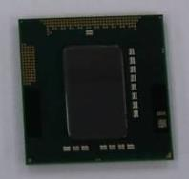
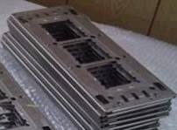
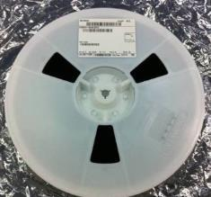
Specifications: Die and Substrates Media
Die size
2x2mm ~ 33x22mm
Min thickness: 0.04mm
Die media
Tape and reel
Sizes: 8,12,16,24,32,44,56mm
Reel diameter: 330mm
Waffle pack
2” x 2” or 4” x 4”
Wafer Frame 8”,12” (flip/non-flip)
Firebird W Substrate
Wafer
Max Diameter 310mm x 2mm thick
Firebird S Substrate
Singulated substrate
10mm ~ 110mm
Max aspect ratio: 3
Strip substrate
50 x 125mm ~ 125 x 250mm
Min thickness: 0.17mm
Substrate media
JEDEC tray
Strip on Carrier with magnetic captive frame
Boat Carrier
2016-09-07
Page 3

Slide 4
Configuration for Intel Chip to Wafer
Main Bonder
Firebird W for 12” wafer substrate (1BH 1BS)
Substrate Input
EFEM ← if manual load unload is acceptable, we may not need this.
Die input
WFM
TnR
Waffle Pack ← please confirm if need this
Operation Unit
Pulse Heater 14mmx14mm
Flux Dipping unit LDU-X
May consider re-use the LDU-X demo unit that we are going to ship to Chandler
Please advise if pre-applied flux spray is an option for the process.
If Intel has a spray machine that can accept input wafer from EFEM.
2016-09-07
Page 4

Slide 5
Configuration for Intel C2W
Collaterals
Die size
Sample 1: 7.3mmx7.3mm x thickness? 8” wafer on 12” wafer ring?
Sample 2: 12.86586mm x 13.47469mm x thickness? 12” wafer on 12” wafer ring
WFM
Ejector Kit (to be defined)
Flip Arm nozzle, Pick nozzle
Firebird
12” ceramic pedestal (assume universal design for 8” and 12” wafer)
BH Nozzle (provide by Intel / may consider make Si one for temporary use)
DPA nozzle
If flux dipping
DPA nozzle for flux dipping
Die holder on DTA
Flux plate (please advise cavity depth required)
2016-09-07
Page 5

Slide 6
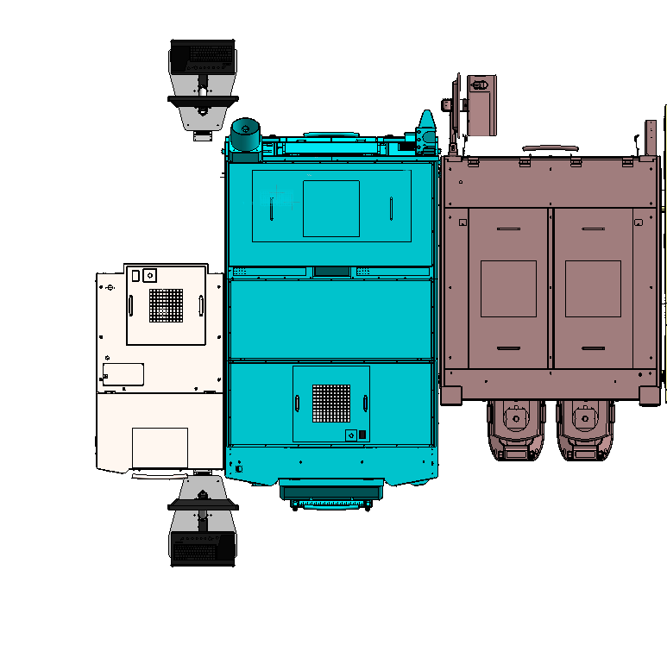
Configuration for WFM + Firebird W (with TnR, 14mm heater) + EFEM
2500
3850
2500
1450
930
1560
1600
4090
2016-09-07
Page 6

Slide 7
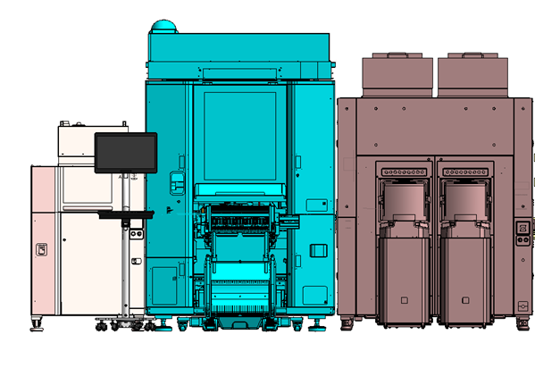
Configuration for WFM + Firebird W + EFEM
Front view
2450
2200
1680
2016-09-07
Page 7

Slide 8
END

